Slide 1

Noida Institute of Engineering and Technology, Greater Noida
High Performance Computing
Unit: v
OpenMP
Mr. Tushar
Assistant Professor
Department of CS
( B Tech 2nd Year)

Slide 2

Faculty Profile
FACULTY PROFILE
Name of Faculty: Mr. Tushar
Designation & Department: Assistant Professor, CS
Qualification: B.E, M.Tech
Experience: 1 Year

Slide 3

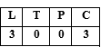
Evaluation Scheme
B.Tech. (Computer Science AIML)
Core subject
3rd SEMESTER
PREDICTIVE ANALYTICS

Slide 4

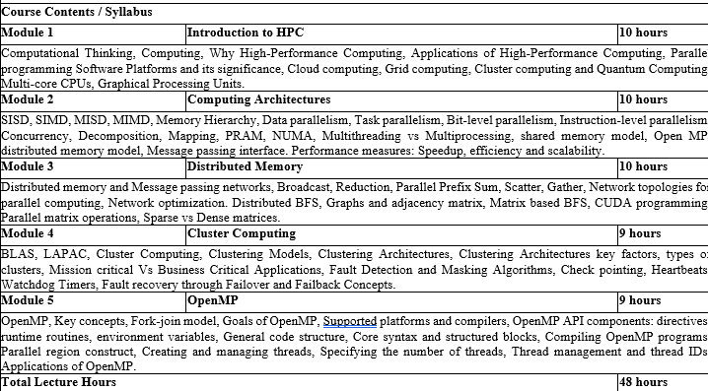
Course Contents / Syllabus

Slide 5
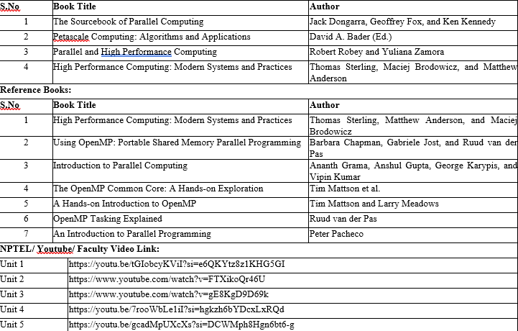
Book Title/ External Links as per Syllabus

Slide 6

Branch wise Applications
Computer science encompasses a diverse array of specialized fields that address modern technological challenges and innovations. Artificial Intelligence (AI) & Machine Learning (ML) empower systems to perceive, learn, and make decisions—from voice assistants and medical diagnostic tools to autonomous vehicles . Data Science & Big Data blend statistics, data modeling, and programming to uncover insights for business intelligence, fraud detection, and predictive analytics. Software Engineering focuses on the full lifecycle of building robust applications—from mobile and web platforms to enterprise and industrial systems . In Cybersecurity & Cryptography, specialists design secure protocols and systems to protect networks, financial infrastructure, and sensitive personal data. Cloud Computing & DevOps enable scalable on-demand services, powering online gaming, streaming, and enterprise applications with automated deployment pipelines . Fields like Computer Graphics & Visualization, Computer Vision, and HCI focus on visual, interactive, and user-centric computing, driving VR/AR, gaming, medical imaging, and intuitive interfaces. Algorithms & Data Structures form the theoretical backbone, optimizing search, encryption, and data retrieval while informing compiler and database design. At the hardware level, Computer Architecture & Embedded Systems support IoT, smart devices, and robotics through efficient design of processors and sensors . Blockchain & Distributed Systems revolutionize secure, decentralized applications in finance and supply chains. Emerging areas like Quantum Computing and Neuromorphic/Biological Computing promise breakthroughs in simulation, optimization, and ultra-efficient intelligent systems—whether using qubits to accelerate drug discovery or neuronal circuits to mimic brain-like computation .

Slide 7
Course Objective
The objective of this course is -
Fundamental HPC Concepts & Terminology Introduce students to essential HPC concepts like parallelism, scaling, and performance (speedup vs. efficiency). Explain why HPC is vital across scientific and engineering domains
Understanding Modern Architectures Cover shared‑memory and distributed systems (clusters, GPUs, accelerators), their architectures, and how hardware design influences software performance.
Mastery of Parallel Programming Models Teach key parallel programming paradigms:
Shared memory: OpenMP
Distributed memory: MPI
Hardware-accelerated: CUDA, OpenCL, OpenACC

Slide 8
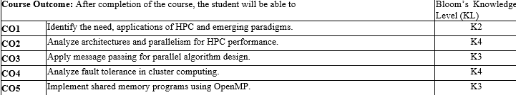

Course Outcomes

Slide 9
Program Outcomes
Engineering Graduates will be able to Understand:
1. Engineering knowledge
2. Problem analysis
3. Design/development of solutions
4. Conduct investigations of complex
5. Modern tool usage
6. The engineer and society
7. Environment and sustainability
8. Ethics
9. Individual and team work
10. Communication
11. Project management and finance
12. Life-long learning

Slide 10
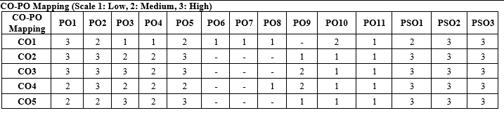
CO-PO Mapping

Slide 11
Program Specific Outcomes (PSOs)
PSO’s
At the end of the program, the student will be able to-
PSO 1: Apply suitable techniques, modern tools to solve complex engineering problems in the field of computer science.
PSO 2: Design and optimize, ethical and innovative solutions for the betterment of the society.
PSO 3: Work as an individual or lead in a team with good communication and engage in life-long learning.

Slide 12
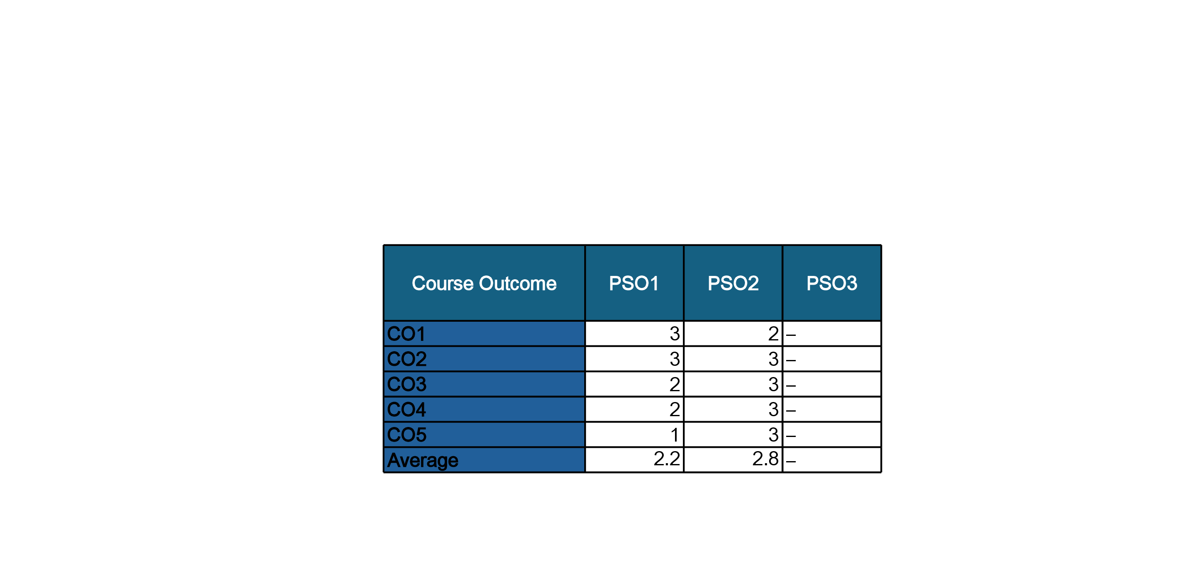
COs and PSOs Mapping

Slide 13
Program Educational Objectives (PEOs)
PEO’s
The graduates of B.Tech Computer Science program will-
PEO1: Have successful careers in the field of Computer Science and pursue higher education.
PEO2: Engage in research and provide innovative solution to real world problems of the society with ethical responsibilities.
PEO3: Demonstrate effective communication, work as an individual or as a team and engage in life-long learning.

Slide 14
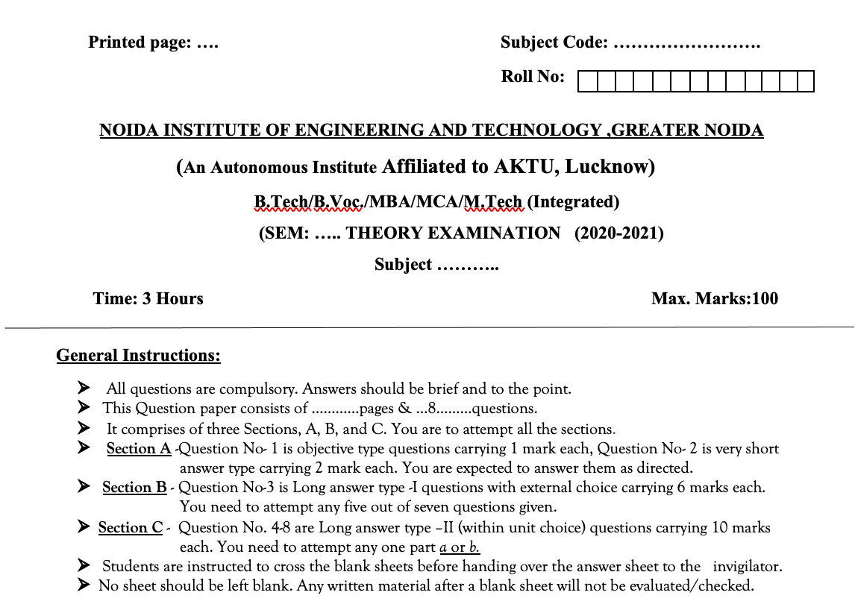
Question Paper Template

Slide 15
Question Paper Template
 |  | SECTION – A |  | CO
 | Attempt all parts- |  | [10×1=10]
 | 1-a. | Question- | (1)
 | 1-b. | Question- | (1)
 | 1-c. | Question- | (1)
 | 1-d. | Question- | (1)
 | 1-e. | Question- | (1)
 | 1-f. | Question- | (1)
 | 1-g. | Question- | (1)
 | 1-h. | Question- | (1)
 | 1-i. | Question- | (1)
 | 1-j. | Question- | (1)
2. | Attempt all parts- |  | [5×2=10] | CO
 | 2-a. | Question- | (2)
 | 2-b. | Question- | (2)
 | 2-c. | Question- | (2)
 | 2-d. | Question- | (2)
 | 2-e. | Question- | (2)
SECTION – B |  |  |  | CO
3. | Answer any five of the following- |  | [5×6=30]
 | 3-a. | Question- | (6)
 | 3-b. | Question- | (6)
 | 3-c. | Question- | (6)
 | 3-d. | Question- | (6)
 | 3-e. | Question- | (6)
 | 3-f. | Question- | (6)
 | 3-g. | Question- | (6)
SECTION – C |  |  |  | CO
4 | Answer any one of the following- |  | [5×10=50]
 | 4-a. | Question- | (10)
 | 4-b. | Question- | (10)
5. | Answer any one of the following-
 | 5-a. | Question- | (10)
 | 5-b. | Question- | (10)
6. | Answer any one of the following-
 | 6-a. | Question- | (10)
 | 6-b. | Question- | (10)
7. | Answer any one of the following-
 | 7-a. | Question- | (10)
 | 7-b. | Question- | (10)
8. | Answer any one of the following-
 | 8-a. | Question- | (10)
 | 8-b. | Question- | (10)

Slide 16
Result Analysis
Subject Result: NA
Department Result: NA
Faculty-Wise Result: NA
High Performance computing Unit 5

Slide 17
Prerequisite and Recap
Prerequisites:
Programming Fundamentals:
Languages: Proficiency in C, C++, or Fortran – essential for working
Recap:
High-Performance Computing, Applications of High-Performance Computing

Slide 18
Brief Intro of Subject with video
High Performance Computing (HPC) focuses on solving complex computational problems using parallel and distributed computing technologies. In today’s era of large-scale data and simulation-driven systems, HPC enables faster processing and analysis by harnessing the power of modern hardware and software tools like multi-core processors, clusters, grids, and even quantum systems.
Students learn:
Core concepts of parallelism
Architectural models like SIMD, MIMD
Programming using OpenMP and MPI
Fault-tolerant mechanisms in cluster systems
This course builds the foundation to design, implement, and analyze performance-driven software and systems used in scientific research, machine learning, big data, etc.

Slide 19

OpenMP
What is OpenMP?
Open Multi-Processing API for shared memory parallel programming
Developed for:
C, C++, Fortran
Used for:
Multi-core processors
Parallelizing loops, tasks, and regions of code

Slide 20
OpenMP
OpenMP (Open Multi-Processing) is an API that supports multi-platform shared memory multiprocessing programming in C, C++, and Fortran.
It allows the creation of parallel programs easily using compiler directives
.OpenMP is portable and scalable across different architectures (Windows, Linux, UNIX).
Mainly used for shared memory architectures.

Slide 21
OpenMP: Key Concepts
Concept | Description
Shared Memory | All threads can access global (shared) variables.
Parallel Region | A section of code that runs in parallel using multiple threads.
Work Sharing | Splitting tasks (like loops) among threads.
Synchronization | Controlling access to shared data to avoid race conditions.
Fork-Join Model | Master thread creates ("forks") multiple threads; at the end, they join back.

Slide 22
OpenMP: QUIZ
What does OpenMP stand for? A) Open Multiprocessing Protocol B) Open Memory Processing C) Open Multi-Processing D) Open Multi-Processing
OpenMP is primarily designed for which type of memory model? A) Distributed memory B) Shared memory C) Virtual memory D) Flash memory
Which programming languages is OpenMP developed for? A) Python, Java, and C# B) C++, Rust, and Go C) C, C++, and Fortran D) JavaScript, PHP, and Perl

Slide 23
OpenMP
What is the primary use of OpenMP? A) Encrypting files using multiple threads B) Managing distributed database clusters C) Parallelizing loops, tasks, and regions of code D) Compressing multimedia files
OpenMP is typically used on which type of processors? A) Single-core processors B) ARM microcontrollers C) Multi-core processors D) GPU clusters only

Slide 24
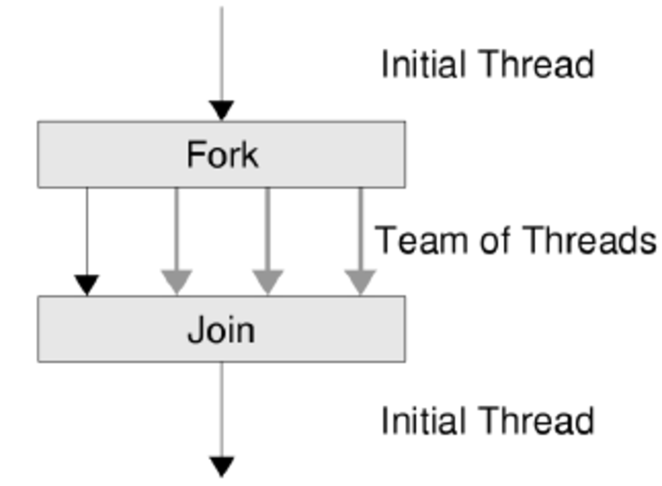
Key concepts
Fork-Join Model
Fork: The master thread creates (forks) multiple threads to execute tasks in parallel.
Join: After completing the parallel tasks, threads synchronize (join) back into the master thread.

Slide 25
Key concepts
The Fork-Join model is the core execution model used in OpenMP to enable parallelism. It begins with a single master thread, which runs the program sequentially until it encounters a parallel region.
Fork Phase: When the program reaches a parallel block (e.g., #pragma omp parallel), the master thread forks a team of worker threads. All threads, including the master, then execute the code inside the parallel region concurrently. The number of threads created depends on system settings or user-defined configuration (like omp_set_num_threads() or OMP_NUM_THREADS).
Join Phase: After the parallel region is completed, all worker threads join back with the master thread. At this point, only the master thread continues executing the remaining sequential part of the program.

Slide 26
Key concepts
This model enables developers to parallelize specific sections of code while keeping the rest of the program simple and serial. It's efficient for tasks like loop parallelism and data processing, where sections of code can be executed independently across multiple threads.

Slide 27
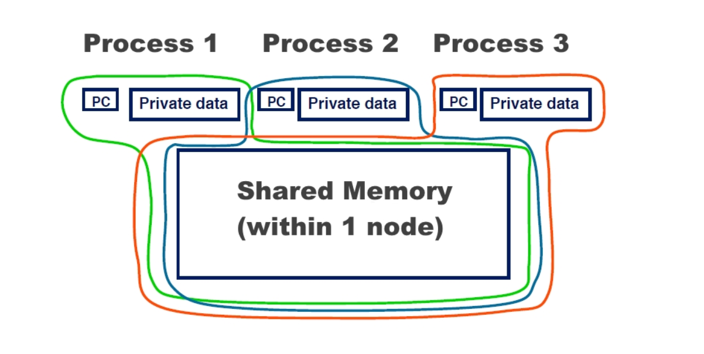
Key concepts
Shared vs Private Variables
Shared: Variables accessible by all threads (e.g., global counters).
Private: Each thread has its own copy; changes are not seen by others.

Slide 28
Key concepts
Definition:Shared variables are those that all threads can access and modify during parallel execution.
memory Behavior:A single memory location is used by all threads, meaning changes made by one thread are visible to all others.
Common Use Cases: Useful when multiple threads need to update or read the same data — for example, updating a shared counter or accumulating a global sum.
Risk: Shared variables can lead to race conditions, where the result depends on the timing of thread execution. To prevent this, synchronization techniques like #pragma omp critical, #pragma omp atomic, or reduction should be used.

Slide 29
Key concepts
Feature | Shared | Private
Accessibility | All threads access same variable | Each thread has its own copy
Memory location | One shared location | Separate location per thread
Visibility | Changes visible to all threads | Changes visible only to that thread
Risk | Race conditions if unsynchronized | No risk of interference

Slide 30
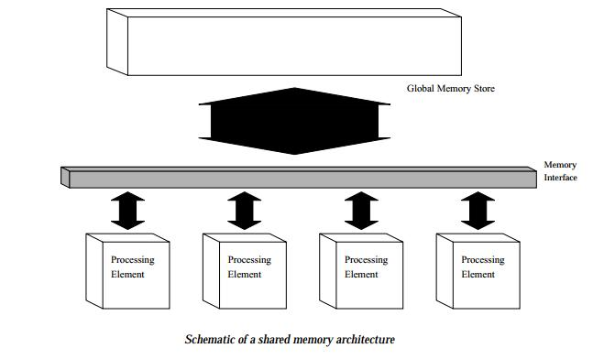
Key concepts

Slide 31
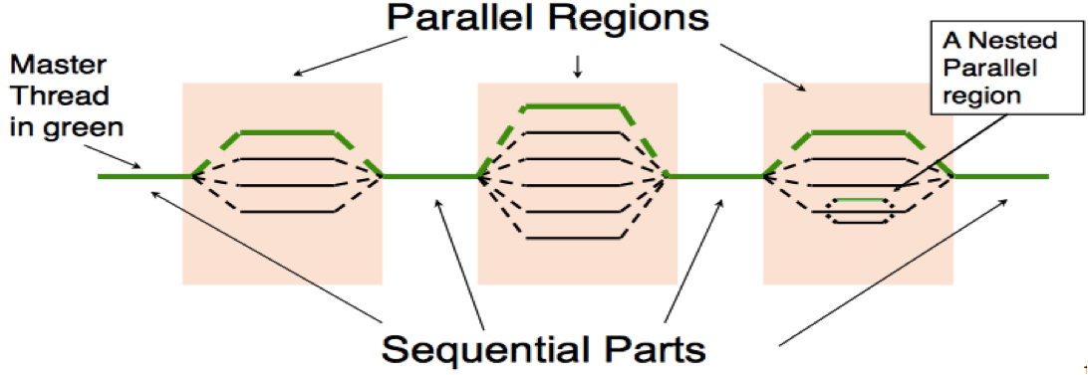
Key concepts
Thread-based Parallelism
Multiple threads run simultaneously, each handling a portion of the task.
Improves performance on multi-core processors by dividing work among cores.

Slide 32
Key concepts
Thread-based Parallelism
Thread-based parallelism is a programming model where multiple threads are created to execute tasks concurrently. Each thread performs a part of the overall task, enabling the program to utilize multiple processor cores simultaneously for faster execution.
How It Works:
The main program creates multiple threads.
These threads execute in parallel, sharing the system’s CPU resources.
The workload is divided among the threads so that each one handles a specific portion.
Once the tasks are complete, threads may synchronize to combine results or continue with dependent operations.

Slide 33
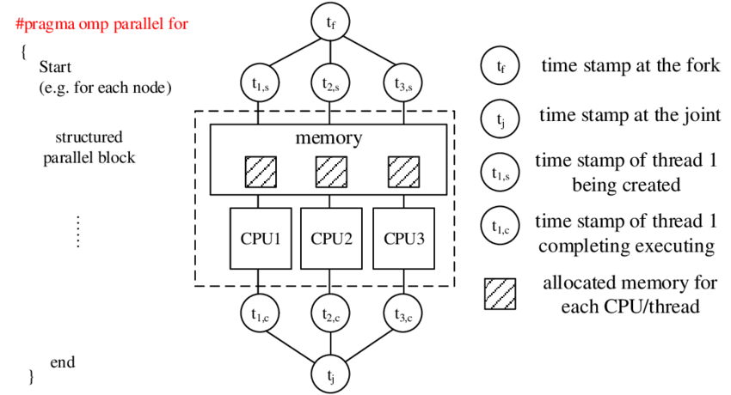
Key concepts

Slide 34
Key concepts
Advantages:
✅ Performance Boost: By using multiple CPU cores, thread-based parallelism can significantly reduce execution time.
✅ Efficient Resource Use: Threads share memory space, making communication between them faster than in process-based parallelism.
✅ Scalability: As more CPU cores are available (e.g., in modern multi-core processors), thread-based programs can scale better.

Slide 35
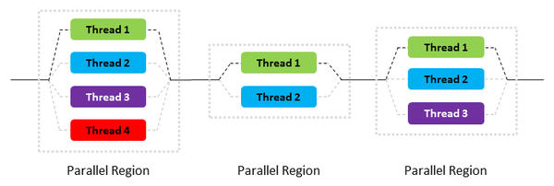
Key concepts

Slide 36

Goals of OpenMP
OpenMP (Open Multi-Processing) is a widely used API that supports multi-platform shared memory multiprocessing programming in C, C++, and Fortran. It is designed with specific goals in mind to make parallel programming more accessible and efficient.
Provide easy-to-use parallel programming support
Ensure code portability and scalability
Achieve performance close to hand-optimized parallel code

Slide 37
Goals of OpenMP
Summary Table:
Goal | Description
Easy-to-Use | Simple directives make it easy to write and understand parallel code
Portable and Scalable | Works across platforms and scales with hardware
High Performance | Offers performance close to low-level, hand-tuned parallel implementations

Slide 38




Supported Platforms and Compilers
Supported Platforms:
Linux,
Windows,
macOS
Compilers Supporting OpenMP:
GCC (GNU Compiler Collection)
Intel C/C++ Compiler
Clang
MS Visual C++

Slide 39
Components of OpenMP API
Compiler Directives (Pragmas)
Special instructions (e.g., #pragma omp parallel) inserted into code.
Tell the compiler how to parallelize specific sections.
Control parallel regions, loops, data sharing, synchronization, etc.
Runtime Library Routines
Functions (e.g., omp_get_thread_num(), omp_set_num_threads()) provided by OpenMP.
Used to control and query the parallel environment during program execution.
Environment Variables
Set outside the program to influence its parallel behavior.
Examples:
OMP_NUM_THREADS: sets number of threads.
OMP_SCHEDULE: controls loop scheduling.

Slide 40
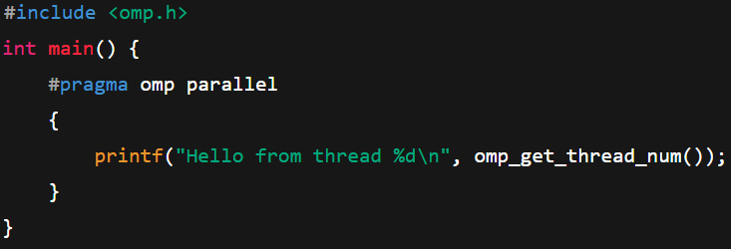
OpenMP Program Structure
General code layout:
Include header <omp.h>
Use #pragma omp directives

Slide 41
Core Syntax and Structured Blocks
#pragma omp parallel – start of a parallel region
#pragma omp for – parallel for-loop
#pragma omp sections – divide tasks among threads
#pragma omp single – execute block by only one thread
#pragma omp critical – protect shared data

Slide 42
Core Syntax and Structured Blocks
Example: Parallel Loop with Structured Block
#include <stdio.h>
#include <omp.h>
int main() {
int i;
// Structured block starts here
#pragma omp parallel for
for (i = 0; i < 5; i++) {
printf("Thread %d is processing iteration %d\n", omp_get_thread_num(), i);
}
// Structured block ends after the for loop
return 0;
}

Slide 43
Assignment Questions on OpenMP
Explain the Fork-Join model in OpenMP.
How does it help in parallel programming?
Write a simple OpenMP program in C/C++ that demonstrates the use of #pragma omp parallel to create multiple threads and print their thread IDs.
Discuss the roles of OpenMP directives, runtime routines, and environment variables in controlling parallel execution. Give examples.
How can you specify the number of threads to be used in an OpenMP program?
Demonstrate with sample code and environment variable settings.

Slide 44
Compiling OpenMP Programs
OpenMP (Open Multi-Processing) is an API that supports multi-platform shared memory multiprocessing programming in C, C++, and Fortran. To use OpenMP features, the program must be compiled with specific compiler flags, and thread support can be verified using built-in OpenMP functions.
Compile using OpenMP flags:
GCC: gcc -fopenmp program.c -o output
Intel: icc –qopenmp
Check thread support using omp_get_max_threads()

Slide 45
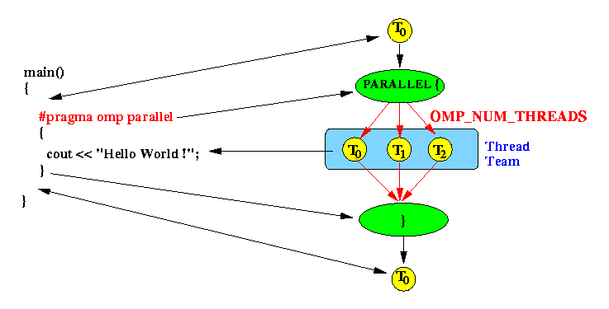
Compiling OpenMP Programs

Slide 46
Creating and Managing Threads
In OpenMP, threads are created automatically when a program enters a parallel region. These threads execute concurrently, allowing efficient use of multiple CPU cores for parallel computing.
Threads created automatically in parallel regions
Default number of threads = number of CPU cores
Functions:
omp_get_thread_num()
omp_get_num_threads()
Nested parallelism (disabled by default)

Slide 47
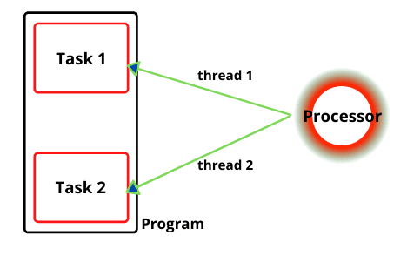
Creating and Managing Threads

Slide 48
Creating and Managing Threads
omp_get_thread_num()
Purpose: Returns the unique thread ID of the current thread.
Usage: Used inside a parallel region to identify which thread is executing a specific block of code.
Thread IDs: Start from 0 up to N-1, where N is the total number of threads.
Example:
#pragma omp parallel
{
int id = omp_get_thread_num();
printf("Thread %d is running\n", id);
}

Slide 49
Creating and Managing Threads
omp_get_num_threads()
Purpose: Returns the total number of threads currently running in the parallel region.
Usage: Useful when you need to know the size of the thread team.
Note: Should be used inside a parallel region, or it will return 1 (the main thread).
Example:
#pragma omp parallel
{
int total = omp_get_num_threads();
printf("Total threads: %d\n", total);
}

Slide 50
Specifying Number of Threads
In OpenMP, controlling the number of threads is essential for optimizing parallel execution. OpenMP provides multiple ways to specify how many threads should be used in a parallel region, allowing developers to manage performance and resource utilization effectively.
Methods to control thread count:
Programmatically: omp_set_num_threads(n)
Environment Variable: OMP_NUM_THREADS
Clause: #pragma omp parallel num_threads(n)

Slide 51
Specifying Number of Threads
Programmatically: omp_set_num_threads(n)
Description: Sets the number of threads to be used in the next parallel region.
Where to use: Call this before entering a #pragma omp parallel region.
Example:
omp_set_num_threads(4);
#pragma omp parallel{
// This block will run with 4 threads
}

Slide 52
Specifying Number of Threads
Environment Variable: OMP_NUM_THREADS
Description: Set this variable in the terminal or shell to define the default number of threads for all parallel regions.
Persistent across runs if set in shell config (like .bashrc).
Example (in terminal):
export OMP_NUM_THREADS=4
./a.out

Slide 53
Specifying Number of Threads
Clause in Directive:
#pragma omp parallel num_threads(n)
Description: Directly specifies the number of threads for a specific parallel region.
Overrides any previously set value by omp_set_num_threads() or OMP_NUM_THREADS.
Example:
#pragma omp parallel num_threads(4){
// Executes with exactly 4 threads
}

Slide 54
Thread Management and IDs
In OpenMP, identifying threads is essential for managing their behavior and coordination within parallel regions. Each thread is assigned a unique ID, which can be used for conditional execution or specialized tasks.
Thread identification:
omp_get_thread_num() – returns threadID
omp_get_num_threads() – returns total threads
Master thread has ID = 0
Use thread ID for conditional execution

Slide 55
Applications of OpenMP
OpenMP is widely used to accelerate computational tasks by leveraging multi-core processors. Its parallel programming capabilities make it ideal for performance-critical applications across various scientific, engineering, and real-time domains.
Scientific Simulations
Image & Signal Processing
Machine Learning Models (Preprocessing, Training loops)
Financial Modelling
Game Physics Engines

Slide 56
Assignment Questions on OpenMP
Explain thread management in OpenMP. How are threads created, managed, and destroyed during the execution of a parallel regionWhat are environment variables in OpenMP? Explain the role of OMP_NUM_THREADS and OMP_SCHEDULE.
Explain how you would compile and run an OpenMP program on a Linux system using GCC compiler. Provide the compilation command and a brief explanation.

Slide 57
Assignment Questions on OpenMP
Explain the structure of an OpenMP program with emphasis on the parallel region construct.
Describe the applications where OpenMP can be effectively used.
What are the limitations of OpenMP compared to other parallel programming models like MPI?
Write an OpenMP program to parallelize a for-loop that computes the sum of an array of integers. Discuss the potential issues and how OpenMP addresses them.

Slide 58

Applications of OpenMP
1. Scientific Simulations
Use Case: Weather prediction, climate modeling, molecular dynamics, astrophysics.
Why OpenMP?: These simulations involve massive numerical computations on large datasets. OpenMP helps by parallelizing loops and computations across multiple CPU cores, speeding up the simulation significantly.

Slide 59
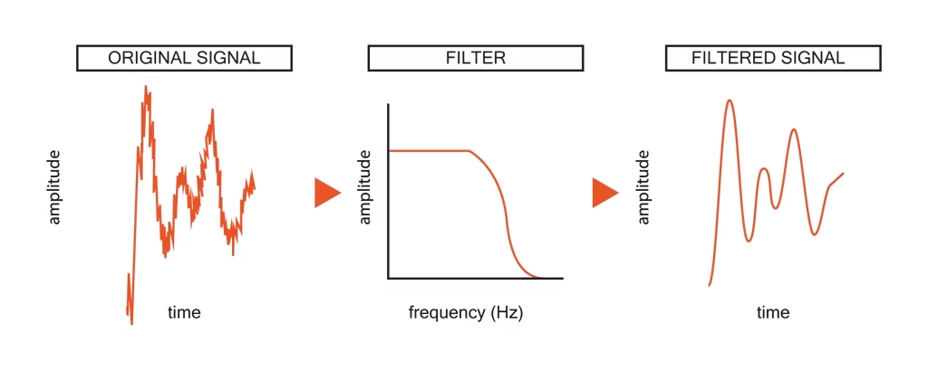
Applications of OpenMP
2. Image & Signal Processing
Use Case: Image filtering, edge detection, Fourier transforms, noise reduction.
Why OpenMP?: Processing each pixel or signal segment can be done independently, making them ideal for parallelization. OpenMP improves processing speed in real-time applications like medical imaging or audio processing.

Slide 60
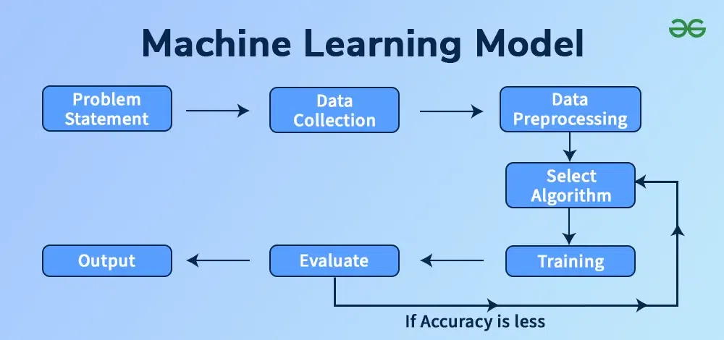
Applications of OpenMP
3. Machine Learning Models (Preprocessing, Training Loops)
Use Case: Data normalization, feature extraction, model training (especially for CPU-based libraries).
Why OpenMP?: ML workflows often involve repetitive, data-parallel tasks. OpenMP allows parallel preprocessing and faster CPU-based model training loops in frameworks like Scikit-learn or TensorFlow (when not using GPU).

Slide 61

Applications of OpenMP
4. Financial Modelling
Use Case: Risk analysis, Monte Carlo simulations, option pricing models.
Why OpenMP?: These computations involve heavy mathematical operations that can be run concurrently. OpenMP enables fast parallel execution of thousands of simulations.

Slide 62
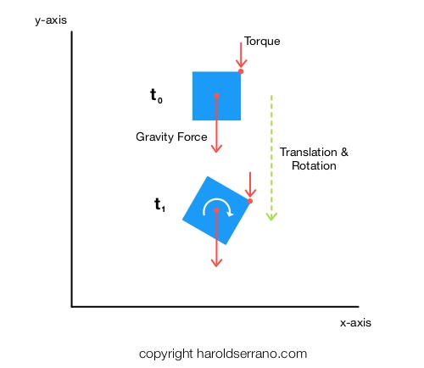
Applications of OpenMP
5. Game Physics Engines
Use Case: Collision detection, fluid dynamics, particle systems, character animation.
Why OpenMP?: Game engines use real-time calculations where parallel threads can handle different physics components simultaneously, reducing CPU load and enhancing frame rates.

Slide 63
OpenMP MCQs with Answers
What is the primary programming model used by OpenMP? A) Message Passing Interface (MPI) B) Fork-Join Model C) Dataflow Model D) Actor Model
Which of the following is NOT a component of the OpenMP API? A) Directives B) Runtime routines C) Environment variables D) Garbage collector

Slide 64
OpenMP MCQs with Answers
What is the default behavior of an OpenMP parallel region regarding the number of threads? A) One thread only B) Maximum number of available processors C) Number specified by the user or system environment D) Number of processes running on the system
Which directive is used to specify a parallel region in OpenMP? A) #pragma omp parallel B) #pragma omp for C) #pragma omp section D) #pragma omp critical

Slide 65
OpenMP MCQs with Answers
5 How do you specify the number of threads in an OpenMP program? A) omp_set_num_threads() function B) Setting environment variable OMP_NUM_THREADS C) Both A and B D) Using a command line argument
6 Which of the following is true about thread IDs in OpenMP? A) All threads have the same thread ID B) Thread IDs are unique integers starting from 0 C) Thread IDs are assigned randomly D) Thread IDs are always even numbers

Slide 66
OpenMP MCQs with Answers
What happens at the end of an OpenMP parallel region? A) Threads continue running indefinitely B) Threads are joined back into the master thread C) Threads are terminated permanently D) Threads are duplicated
Which OpenMP directive is used for specifying work-sharing constructs like loops? A) parallel B) for C) section D) single

Slide 67
OpenMP MCQs with Answers
Which platforms support OpenMP? A) Windows only B) Linux only C) UNIX, Linux, and Windows D) Embedded systems only
Which of the following is NOT a goal of OpenMP? A) Ease of programming B) Portability C) Scalability across multiple nodes in a cluster D) Performance

Slide 68
Summary
OpenMP is ideal for shared-memory parallelism
Simple directives allow easy integration with existing code
Flexibility in managing threads, workload, and data
Widely supported and efficient for multicore programming

Slide 69
Summary
Recommended YouTube Tutorials on OpenMP
“Tim Mattson – Introduction to OpenMP” (Intel) An accessible series by one of OpenMP’s core contributors, covering basics and core constructs.
“OpenMP Tutorial: Hello World & Parallel For Loops” (LLNL) Covers fundamental usage, compilation flags, and loop parallelization in C/C++.
“OpenMP In C++ – Fast Guide” A step-by-step demo of #pragma omp parallel for, thread IDs, and scheduling.
“OpenMP Task Parallelism Deep Dive” Explains more advanced features like task constructs, synchronization, and reduction.
“Hands-on OpenMP – Parallel Sum & Matrix Multiply” Builds a parallel reduction and matrix multiplication example, ideal for practical programming.

Slide 70
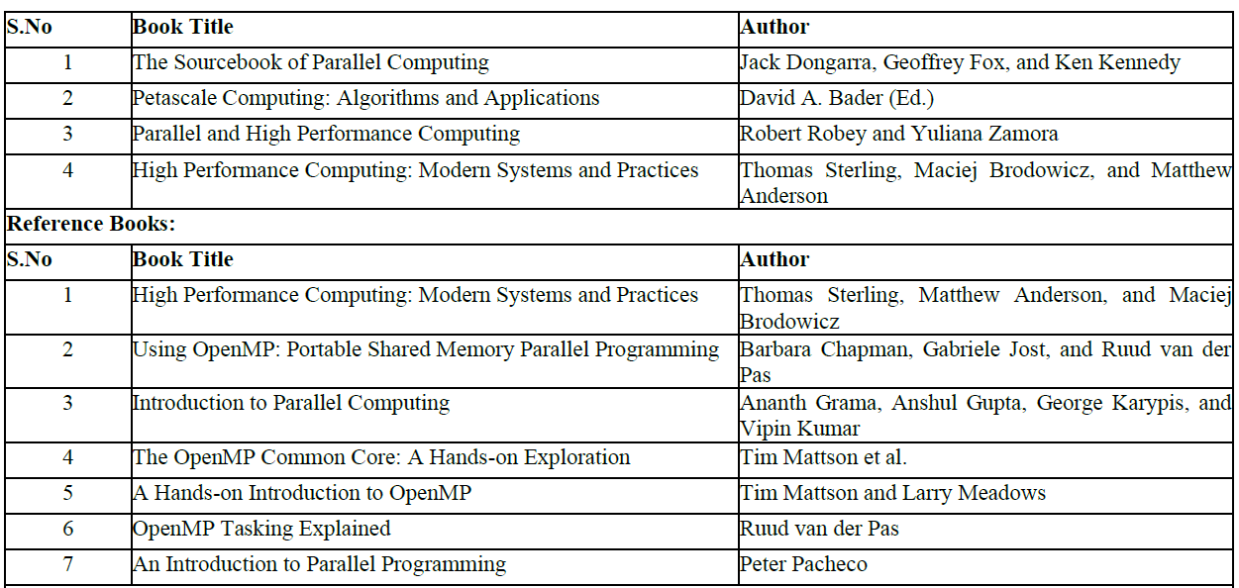
References

Slide 71
Thank You

